Slide 1

1
ECTE250
ENGINEERING
DESIGN
AND
MANAGEMENT
2
Winter 2025 / Spring 2025
Report (Deliverable 2 and 6)

Slide 2
Reports

Slide 3

ECTE250 Reports
◻ Teams has to produce reports
and Deliverable 6.
for Deliverable
2
◻ Short technical reports are
also
required
for
Deliverable
3,
Deliverable 4
and
Deliverable 5.
3

Slide 4
ECTE250 Reports
◻ Formatting
◻ Contents
◻ Figures, Tables,
◻ Acronym
◻ Equations
Diagrams
◻ Cross References
◻ Originality
◻ Examples
4

Slide 5
Formatting
◻ Font: Times New Roman, Arial
◻ Size: 11 or 12 pts
◻ Line spacing: between 1.1 and 1.5 lines
◻ Margin: 1” on all sides (can be printed)
◻ Alignment: Justified
◻ Use header (team name,
footer (page number).
deliverable
name)
and
5

Slide 6
Formatting
◻ Use consistent fonts
◉ 1 Heading
for heading
and sub
heading
■ 1.1
■
Sub-Heading
1.1.1 Sub-Sub-Heading
6

Slide 7
Contents
◻ Cover Sheet
◻ Table of Contents
(i.e. Index)
◻ Body (must be within the word count)
◉ Required sections detailed in Deliverable guidelines
◉ Use appropriate subsections
◻ Appendices
◉ Additional material such as detailed tables, circuit, source code,
complete Gantt chart/PND, which are too detailed for the report.
Must be referenced in the body.
7

Slide 8
Figures, Tables, Diagrams
◻ Use figures, illustrations, diagrams, to explain
visualize difficult concepts
◉ E.g. block diagram for your system design, state
and
diagram for your state machine, flowchart for system
functionalities, Gantt chart for plan, illustration of the
system deployment in physical space, etc…
◻ These figures can be reused for your presentation!
8

Slide 9
Figures, Tables, Diagrams
◻ All figures and tables must be CAPTIONED
◉ The caption should include a figure number, and
a
detailed description (i.e. the reader can grasp what’s
the meaning of that figure even without reading the report).
◉ In the caption include a legend for your symbol if
needed (semantic of colors, shapes, etc…)
9

Slide 10
Figures,
Tables, Diagrams
◻ All figures
and tables must cited in the text.
◻ All figures
should be placed right below
the
paragraph in which they are cited.
◻ Cite the source of the image in case you
produce the image/diagram/illustration
did
not
10

Slide 11
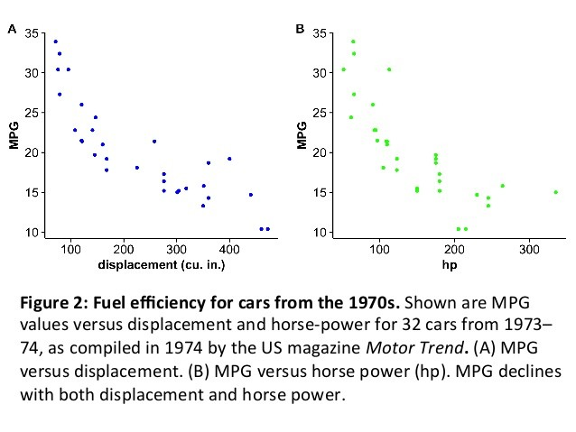
Figures, Tables, Diagrams
◻ Example
The result of our study are summarized in the two plots of Figure 2, which describes fuel consumption versus displacement and horse power for cars
manufactured in 1970s. Visualized data shows an evident decline
of the Miles
Per Gallon when
consumption.
engine
size
and
power
increases,
hence
a
higher
fuel
11

Slide 12
Acronym
◻ An acronym is a word or name formed as an
abbreviation from the initial components in a phrase or a word, usually individual letters.
◻ You must spell-out acronyms at first use. Example
In 1965 Cooley and Tukey introduced the Fast Fourier Transform (FFT). The FFT is a fast algorithm for the computation of the Discrete Fourier Transform (DFT).
◻ There is no need for a table of abbreviations.
12

Slide 13
Equations
◻ All equations must be entered with MS Equation
Editor (or equivalent).
◻ All equations must be numbered and cited in the
text – when necessary – using their number.
◻ All variables must be explained in the text following
the equation (if not implicitly clear)
13

Slide 14
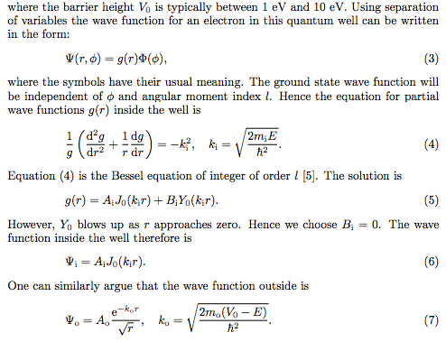
Equations
14

Slide 15
Cross References
◻ You can use cross references to support your
arguments/design, or to describe where you
took
inspiration from
(similar works).
◻ Cross reference
is
a
reference
to
an external
source
of
information.
15

Slide 16
Cross References
◻ Each reference must be:
◉ Cited in the text
◉ Included in the reference list (at the end of your report)
◻ Use Harvard reference style
https://www.mendeley.com/guides/harvard-citation-guide
16

Slide 17
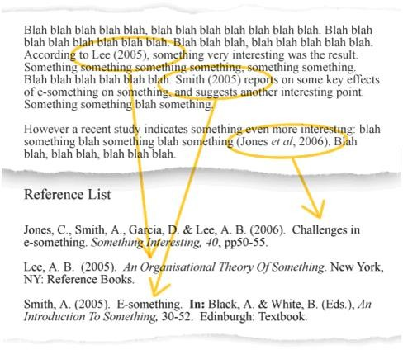
Cross
References
17

Slide 18
Cross References
◻ An URL is not a reference.
◻ If you want/need to include
an URL, use footnotes.
◻ Reference should be books, articles, papers (i.e. peer
reviewed and reliable source of information).
◻ You can refer to web contents as well (the
be reliable, e.g. Wikipedia is fine, a blog
not).
source must
or forum is
18

Slide 19
Cross References
◻ If you have a few references
manually.
you can handle them
◻ If you have many, use a tool
such as Zotero or
Mendeley
(you’ll
have
to
do
that
anyway
in
ECTE451)
19

Slide 20
Originality
◻ All text included
original
in
your report is expected to be
◻ Use double quotes
sources. Example:
to cite periods taken from other
“I took this period from
elsewhere” (Author, Year).
20

Slide 21
Examples
◻ ECTE250
Deliverable
reports
from
previous years upload in Moodle
21

